Slide 1

UNIT V
PUSH DOWN AUTOMATA AND PARSING
CSE322-FLAT

Slide 2
UNIT V SYLLABUS
PUSHDOWN AUTOMATA AND PARSING : Representation of Pushdown Automata, Acceptance by Pushdown Automata, Pushdown Automata: Deterministic Pushdown Automata and non-deterministic Pushdown Automata, Context free languages and Pushdown Automata, PARSING: Top-Down and Bottom-Up Parsing, Description and Model of Pushdown Automata, Pushdown Automata and ContextFree Languages, Comparison of deterministic and non-deterministic versions, closure properties, LL (k) Grammars and its Properties, LR(k) Grammars and its Properties

Slide 3
Pushdown Automata(PDA)
Basic Structure of PDA
A pushdown automaton is a way to implement a context-free grammar in a similar way we design DFA for a regular grammar.
A DFA can remember a finite amount of information, but a PDA can remember an infinite amount of information.
Basically a pushdown automaton is −
"Finite state machine" + "a stack"

Slide 4
A pushdown automaton has three components −
1)an input tape,
2) a control unit, and
3) a stack with infinite size.
The stack head scans the top symbol of the stack.
A stack does two operations −
Push − a new symbol is added at the top.
Pop − the top symbol is read and removed.

Slide 5
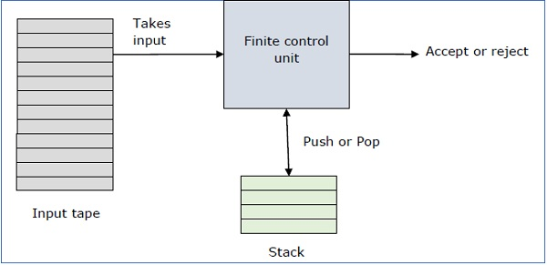
A PDA may or may not read an input symbol, but it has to read the top of the stack in every transition.

Slide 6
DEFINITION OF PDA
A PDA can be formally described as a 7-tuple
(Q, ∑, S, δ, q₀, I, F)
Q is the finite number of states
∑ is input alphabet
S is stack symbols
δ is the transition function: Q × (∑ ∪ {ε}) × S × Q × S*
q₀ is the initial state (q₀ ∈ Q)
I is the initial stack top symbol (I ∈ S)
F is a set of accepting states (F ∈ Q)

Slide 7
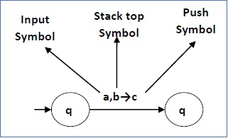
This means at state q₁, if we encounter an input string ‘a’ and top symbol of the stack is ‘b’, then we pop ‘b’, push ‘c’ on top of the stack and move to state q₂.
The following diagram shows a transition in a PDA from a state q₁ to state q₂, labeled as a,b → c −

Slide 8
Terminologies Related to PDA
Instantaneous Description
The instantaneous description (ID) of a PDA is represented by a triplet (q, w, s) where:
q is the state
w is unconsumed input
s is the stack contents

Slide 9
Turnstile Notation
The "turnstile" notation is used for connecting pairs of ID's that represent one or many moves of a PDA. The process of transition is denoted by the turnstile symbol "⊢".
Consider a PDA (Q, ∑, S, δ, q₀, I, F). A transition can be mathematically represented by the following turnstile notation −
(p, aw, Tβ) ⊢ (q, w, αβ)
This implies that while taking a transition from state p to state q, the input symbol ‘a’ is consumed, and the top of the stack ‘T’ is replaced by a new string ‘α’.
Note − If we want zero or more moves of a PDA, we have to use the symbol (⊢*) for it.

Slide 10
POLLING QUESTIONS
The transition a Push down automaton makes is additionally dependent upon the:
a) stack
b) input tape
c) terminals
d) none of the mentioned
Notes:
A

Slide 11
2. With reference of a DPDA, which among the following do we perform from the start state with an empty stack?
a) process the whole string
b) end in final state
c) end with an empty stack
d) all of the mentioned
Notes:
D

Slide 12
3. Halting states are of two types. They are:
a) Accept and Reject
b) Reject and Allow
c) Start and Reject
d) None of the mentioned
Notes:
A

Slide 13
4. Which of the following correctly recognize the symbol ‘|-‘ in context to PDA?
a) Moves
b) transition function
c) or/not symbol
d) none of the mentioned
Notes:
A

Slide 14
5. Which of the following automata takes stack as auxiliary storage?
a) Finite automata
b) Push down automata
c) Turing machine
d) All of the mentioned
Notes:
B

Slide 15
Pushdown Automata Acceptance
There are two different ways to define PDA acceptability.
1. Final State Acceptability:
In final state acceptability, a PDA accepts a string when, after reading the entire string, the PDA is in a final state. From the starting state, we can make moves that end up in a final state with any stack values. The stack values are irrelevant as long as we end up in a final state.
For a PDA (Q, ∑, S, δ, q₀, I, F), the language accepted by the set of final states F is −
L(PDA) = {w | (q₀, w, I) ⊢* (q, ε, x), q ∈ F}
for any input stack string x.

Slide 16
2. Empty Stack Acceptability:
Here a PDA accepts a string when, after reading the entire string, the PDA has emptied its stack.
For a PDA (Q, ∑, S, δ, q₀, I, F), the language accepted by the empty stack is −
L(PDA) = {w | (q₀, w, I) ⊢* (q, ε, ε), q ∈ Q}

Slide 17
Practice Questions
Construct a PDA that accepts
L = {0^{n} 1^{n} | n ≥ 0}

Slide 18
2. Construct a PDA that accepts even palindromes of the form:
L = { ww^{R} | w = (a+b)* }

Slide 19
3. Construct a PDA that accepts
L = {a^nb^nc^m|n,m>=1}

Slide 20
POLLING QUESTIONS
A string is accepted by a PDA when
a.Stack is empty
b.Acceptance state
c.both a and b
d.None of the mentioned
Notes:
C

Slide 21
2. The following move of a PDA is on the basis of:
a.Present state
b.Input Symbol
c.both a and b
d.None of the mentioned

Slide 22
PDA & Context-Free Grammar
If a grammar G is context-free, we can build an equivalent nondeterministic PDA which accepts the language that is produced by the context-free grammar G. A parser can be built for the grammar G.
Also, if P is a pushdown automaton, an equivalent context-free grammar G can be constructed where
L(G) = L(P)

Slide 23
Algorithm to find PDA corresponding to a given CFG
Input − A CFG, G = (V, T, P, S)
Output − Equivalent PDA, P = (Q, ∑, S, δ, q₀, I, F)
Rule 1: δ(q, ε, A) = (q, α) | A-> α is in P
Rule 2: δ(q,a,a)=(q, ε) for every a ∈ Σ

Slide 24
Practice Questions
Convert into PDA for the CFG given:
S-> 0BB, B->0S|1S|0
2. Convert into PDA for the CFG given:
S->aSA, S->bSb|c

Slide 25
Practice QUESTIONS
A PDA machine configuration (p, w, y) can be correctly represented as:
(current state, unprocessed input, stack content)
b) (unprocessed input, stack content, current state)
c) (current state, stack content, unprocessed input)
d) none of the mentioned
Notes:
a

Slide 26
2. Let ∑={0,1}* and the grammar G be:
S->ε
S->SS
S->0S1|1S0
State which of the following is true for the given
a) Language of all and only Balanced strings
b) It contains equal number of 0’s and 1’s
c) Ambiguous Grammar
d) All of the mentioned
Notes:
d

Slide 27
3. A push down automata is said to be _________ if it has atmost one transition around all configurations.
a) Finite
b) Non regular
c) Non-deterministic
d) Deterministic
Notes:
d

Slide 28
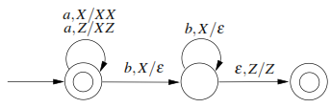
4. Consider the transition diagram of a PDA given below with input alphabet Σ = {a,b} and stack alphabet Γ ={X,Z} .Z is the initial stack symbol. Let L denote the language accepted by the PDA.
Which one of the following is TRUE?
(A) L ={anbn|n≥0} and is not accepted by any finite automata
(B) L ={an|n≥0}∪{anbn|n≥0} and is not accepted by any deterministic PDA
(C) L is not accepted by any Turing machine that halts on every input
(D) L ={an|n≥0}∪{anbn|n≥0} and is deterministic context-free
Notes:
d

Slide 29
Conversion of PDA to CFG
The productions in P are induced by move of PDA as follows:
S productions are given by:
S->[q0 Z0 q] for every q ∈ Q
2. For every popping move:
δ(q ,a, Z)=(q’, ε) induces production
[q Z q’]->a

Slide 30
3. For each push move and No operation :
δ(q ,a, Z)=(q1, Z1,Z2,….Zm) induces many productions [q Z q’]->a [q1 Z1 q2] [q2 Z2 q3]….. [qm Zm q’]
where each state q1,q2,…qm can be any state in PDA.

Slide 31
Practice Questions
Generate CFG for given PDA, M={{q0,q1},{0,1},{x,Z0}, δ, q0, Z0,q1} where δ is given as follows:
δ (q0,1,Z0)=(q`0,xZ0)
δ (q0,1,x)=(q0,xx)
δ (q0,0,x)=(q0,x)
δ (q0, ε,x)=(q1,ε)
δ (q1, ε,x)=(q1,ε)
δ (q1,0,x)=(q1,xx)
δ (q1,0,Z0)=(q1,ε)

Slide 32
Practice question
Let PDA is defined as M={{q1,q2},{a,b},{y,z},q1,z,q2}
Choose the right production in equivalent CFG for the following transition of given PDA as : (q1,b,x) =(q2,€)
[ q1,x,q2] ->b
[ q1,x,q2] ->€
[ q1,x,q1] ->b
[ q1, €,q2] ->b

Slide 33
Pushdown Automata & Parsing
Parsing is used to derive a string using the production rules of a grammar.
It is used to check the acceptability of a string.
Compiler is used to check whether or not a string is syntactically correct.
A parser takes the inputs and builds a parse tree.

Slide 34
A parser can be of two types −
Top-Down Parser − Top-down parsing starts from the top with the start-symbol and derives a string using a parse tree.
Bottom-Up Parser − Bottom-up parsing starts from the bottom with the string and comes to the start symbol using a parse tree.

Slide 35
Design of Top-Down Parser
For top-down parsing, a PDA has the following four types of transitions −
Pop the non-terminal on the left hand side of the production at the top of the stack and push its right-hand side string.
If the top symbol of the stack matches with the input symbol being read, pop it.
Push the start symbol ‘S’ into the stack.
If the input string is fully read and the stack is empty, go to the final state ‘F’.

Slide 36
Design of a Bottom-Up Parser
For bottom-up parsing, a PDA has the following four types of transitions −
Push the current input symbol into the stack.
Replace the right-hand side of a production at the top of the stack with its left-hand side.
If the top of the stack element matches with the current input symbol, pop it.
If the input string is fully read and only if the start symbol ‘S’ remains in the stack, pop it and go to the final state ‘F’.

Slide 37
1. Which of the following derivations does a top-down parser use while parsing an input string?
a) Leftmost derivation
b) Leftmost derivation in reverse
c) Rightmost derivation
d) Rightmost derivation in reverse
Notes:
a

Slide 38
2. A bottom up parser generates __________
a) Rightmost Derivation
b) Right most derivation in reverse
c) Left most derivation
d) Left most derivation in reverse
Notes:
d

Slide 39
Top Down Parser
LL(k) Grammar
An LL parser (Left-to-right, Leftmost derivation) is a top-down parser for a subset of context-free languages . It parses the input from Left to right, performing Leftmost derivation of the sentence.

Slide 40
An LL parser is called an LL(k) parser if it uses k tokens of lookahead when parsing a sentence.
A grammar is called an LL(k) grammar if an LL(k) parser can be constructed from it.

Slide 41
LLR grammars are a proper superset of LL(k) grammars for any k. For every LLR grammar there exists an LLR parser that parses the grammar in linear time.
The LL(k) parser is a deterministic pushdown automaton with the ability to peek on the next k input symbols without reading.

Slide 42
Example
To explain an LL(1) parser's workings we will consider the following small LL(1) grammar:
S → F
S → ( S + F )
F → a
and parse the following input:
( a + a )

Slide 43
An LL(1) parsing table for a grammar has a row for each of the non-terminals and a column for each terminal (including the special terminal, represented here as $, that is used to indicate the end of the input stream).
A list of rules for a leftmost derivation of the input string, which is:
S → ( S + F ) → ( F + F ) → ( a + F ) → ( a + a )

Slide 44
Question 2
P: S → S+X | X,
X → X*Y | Y,
Y → (S) | id
Solution
If the PDA is (Q, ∑, S, δ, q₀, I, F), then the top-down parsing is −
(x+y*z, I) ⊢(x +y*z, SI) ⊢ (x+y*z, S+XI) ⊢(x+y*z, X+XI)
⊢(x+y*z, Y+X I) ⊢(x+y*z, x+XI) ⊢(+y*z, +XI) ⊢ (y*z, XI)
⊢(y*z, X*YI) ⊢(y*z, y*YI) ⊢(*z,*YI) ⊢(z, YI) ⊢(z, zI) ⊢(ε, I)

Slide 45
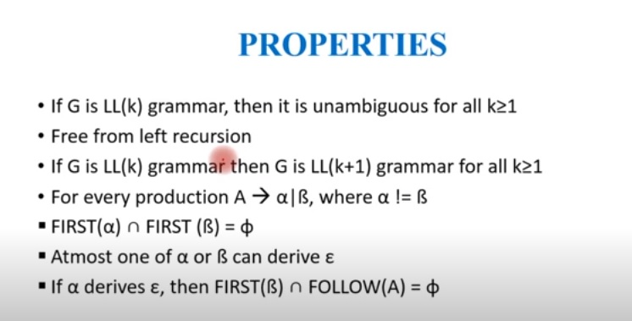
Properties of LL(k) Grammar

Slide 46
Bottom Up Parser
LR(k) Grammar
An LR parser (Left-to-right, Rightmost derivation in reverse) reads input text from left to right without backing up (this is true for most parsers), and produces a rightmost derivation in reverse: it does a bottom-up parse – not a top-down LL parse or ad-hoc parse.

Slide 47
Avoid backtracking or guessing, the LR parser is allowed to peek ahead at k look ahead input symbols before deciding how to parse earlier symbols.
LR parsers are deterministic; they produce a single correct parse without guesswork or backtracking, in linear time.

Slide 48
Start at the leaves and grow toward root
As input is consumed, encode possibilities in an internal state
A powerful parsing technology
LR grammars
  Construct right-most derivation of program
  Left-recursive grammar, virtually all programming language are left-recursive
  Easier to express syntax

Slide 49
Right-most derivation
  Start with the tokens
  End with the start symbol
  Match substring on RHS of production, replace by LHS
  Shift-reduce parsers
    Parsers for LR grammars
    Automatic parser generators (yacc, bison)

Slide 50
Example Bottom-Up Parsing
S → S + E | E
E → num | (S)
(1+2+(3+4))+5 ← (E+2+(3+4))+5 ←(S+2+(3+4))+5
←(S+E+(3+4))+5 ←(S+(3+4))+5 ←(S+(E+4))+5
←(S+(S+4))+5 ←(S+(S+E))+5 ←(S+(S))+5
←(S+E)+5 ←(S)+5 ←E+5
←S+5 ←S+E ←S

Slide 51
Properties of LR(K)
Property 1: Every LR(k) grammar G is unambiguouS

Slide 52
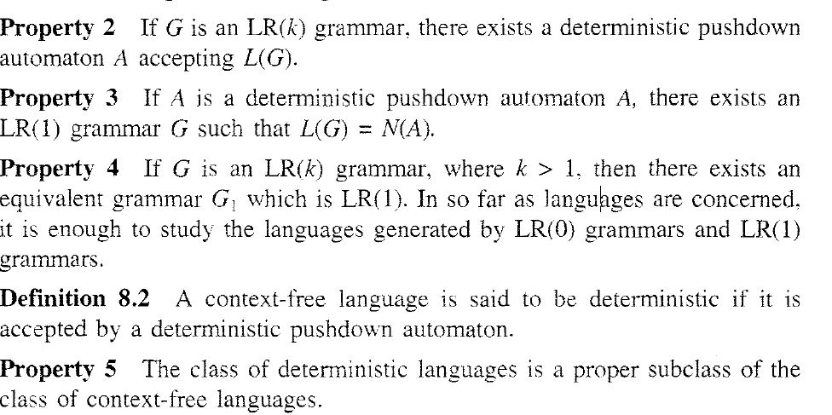
Properties of LR(K)

Slide 53
POLLING QUESTIONS
Which of these is true about LR parsing?
a) Is most general non-backtracking shift-reduce parsing
b) It is still efficient
c) Is most general non-backtracking shift-reduce parsing & It is still efficient
d) None of the mentioned
Notes:
c

Slide 54
2. Which of the following is incorrect for the actions of A LR-Parser I) shift s ii) reduce A->ß iii) Accept iv) reject?
a) Only I)
b) I) and ii)
c) I), ii) and iii)
d) I), ii) , iii) and iv)
Notes:
c

Slide 55
3. When ß (in the LR(1) item A -> ß.a,a) is not empty, the look-head _________
a) Will be affecting
b) Does not have any affect
c) Shift will take place
d) Reduction will take place
Notes:
b

Slide 56
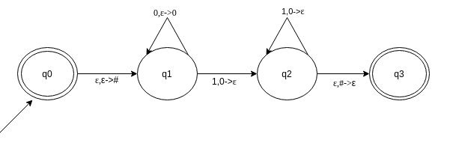
PRACTICE QUESTIONS OF PDA
Q1: Which of the following option resembles the given PDA?
a) {0^{n}1^{n}|n>=0}
b) {0^{n}1^{2n}|n>=0}
c) {0^{2n}1^{n}|n>=0}
d) None of the mentioned

Slide 57
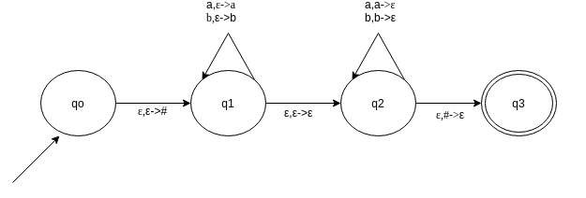
A) {WW^{R}|W=(A+B)*}
B) EPSILON IS CALLED THE INITIAL STACK SYMBOL
C) ALL OF THE MENTIONED
D) NONE OF THE MENTIONED
Q2:

